Slide 1
Intro To artificial Intelligence!

Slide 2
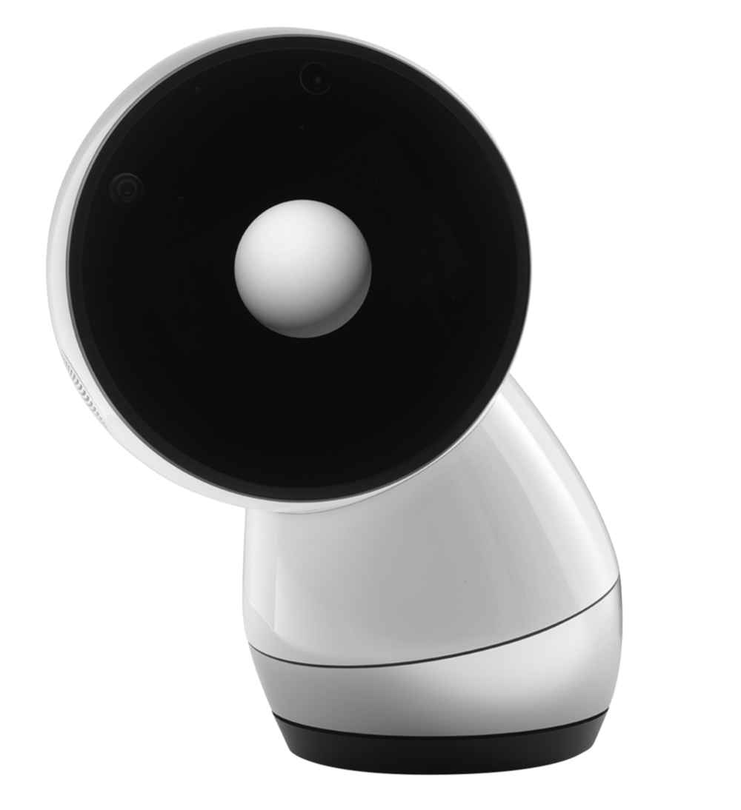
What does
“Artificial Intelligence”
make you think of?

Slide 3
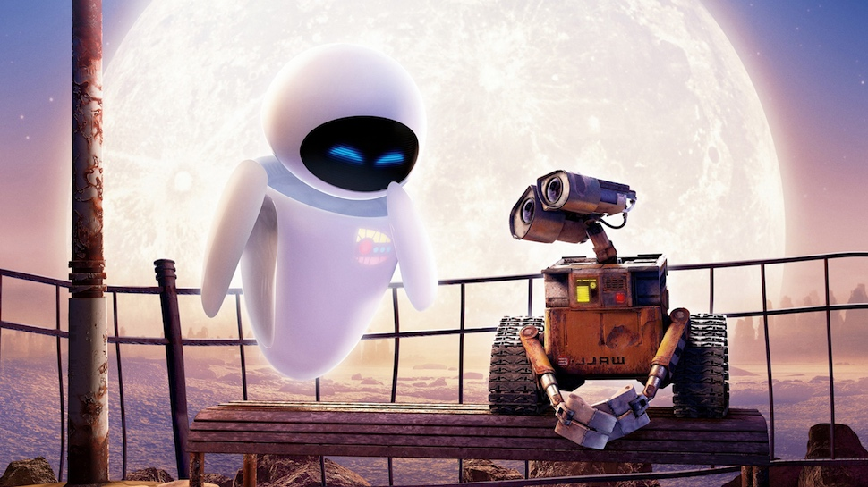
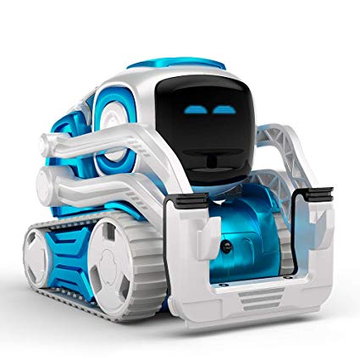
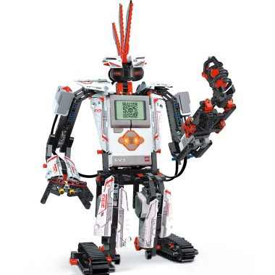
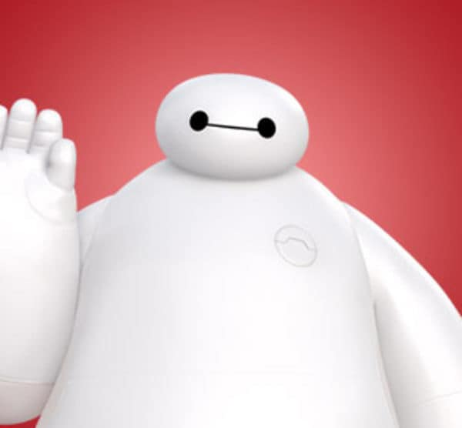
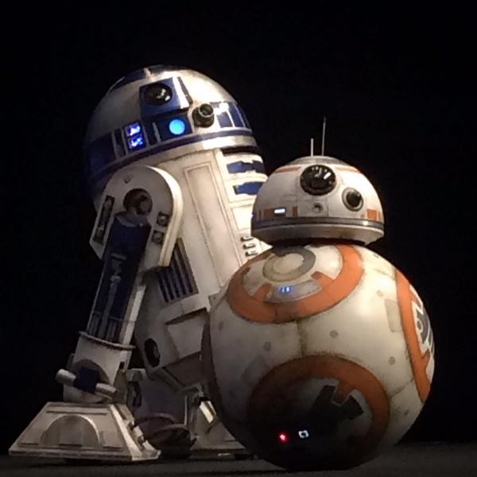
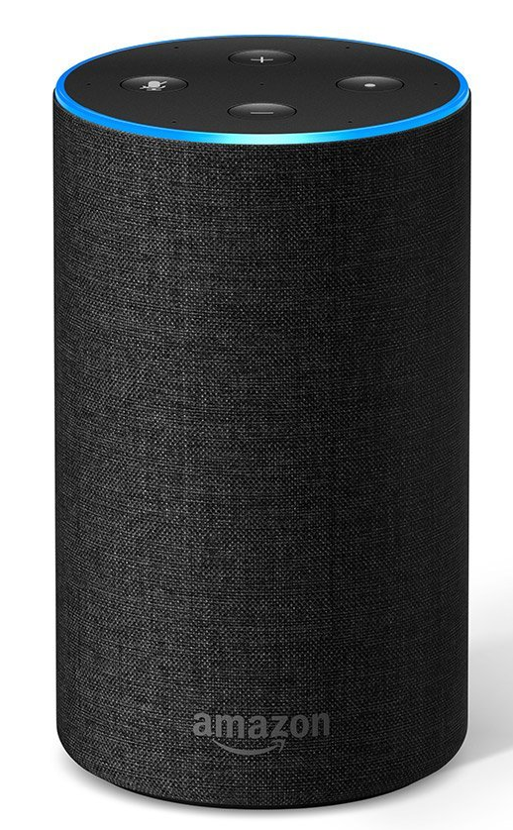
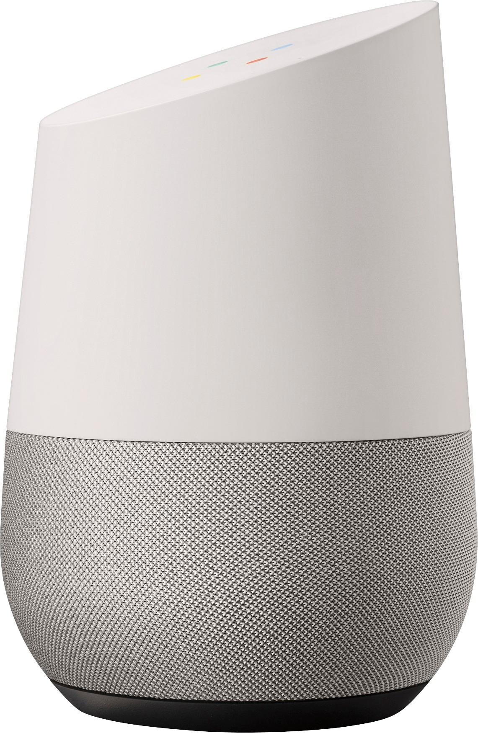
Notes:
What do they all have in common?
What do they do? [How do robots help us]
Cozmo - visual recognition
Alexa/Google home - speech recognition
Are robots the only form of AI?

Slide 4

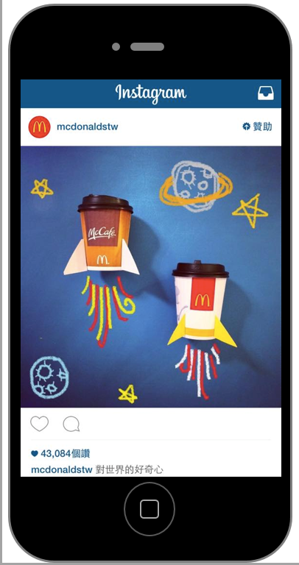
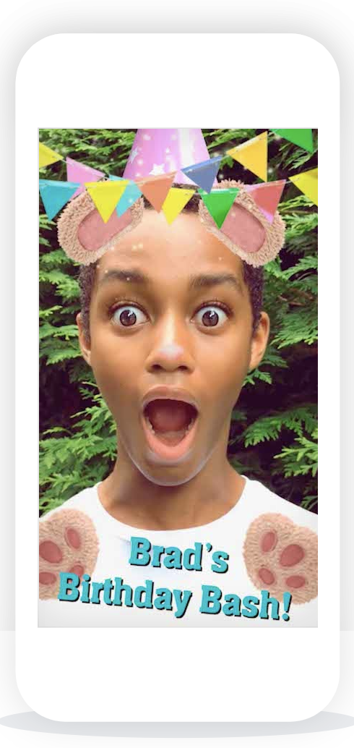
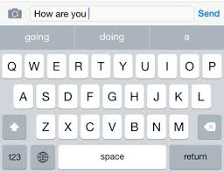
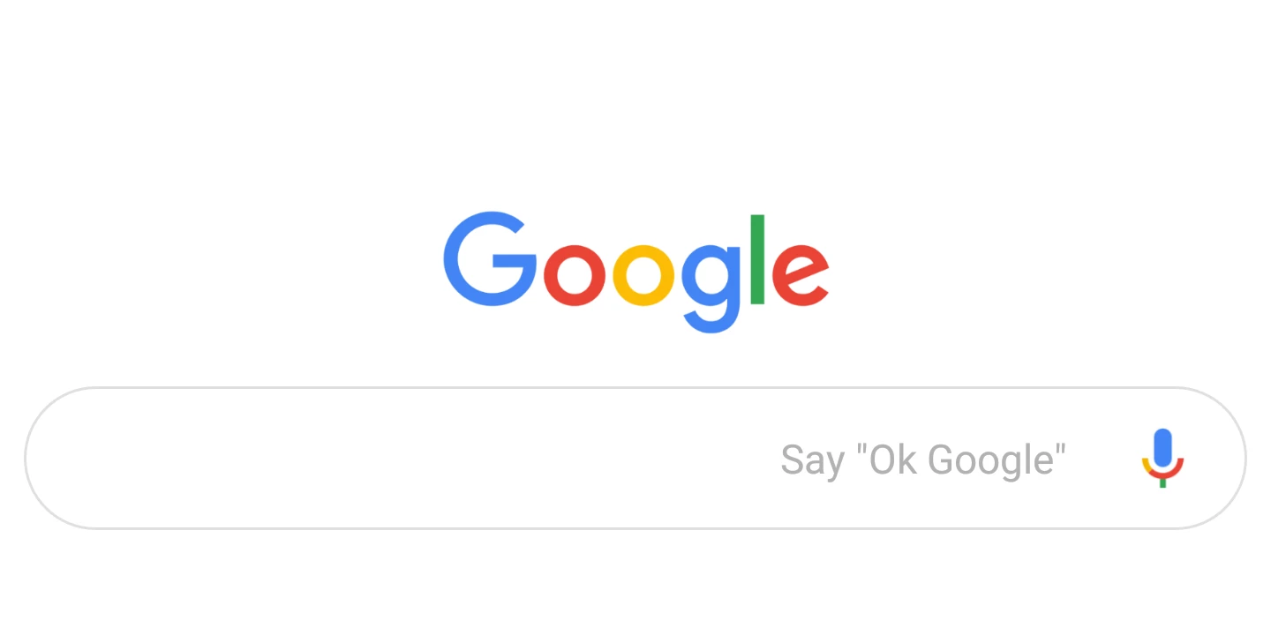
Notes:
How many of you use these?
What do they have in common?

Slide 5
AI has three parts
learning algorithm
prediction!
dataset
Notes:
Short definition
AI trying to predict something in the future or something that the data says
Example of what you predict (weather , what happens in a movie)

Slide 6
AI has three parts
dataset
Notes:
Short definition

Slide 7
What is a
“dataset”?

Slide 8
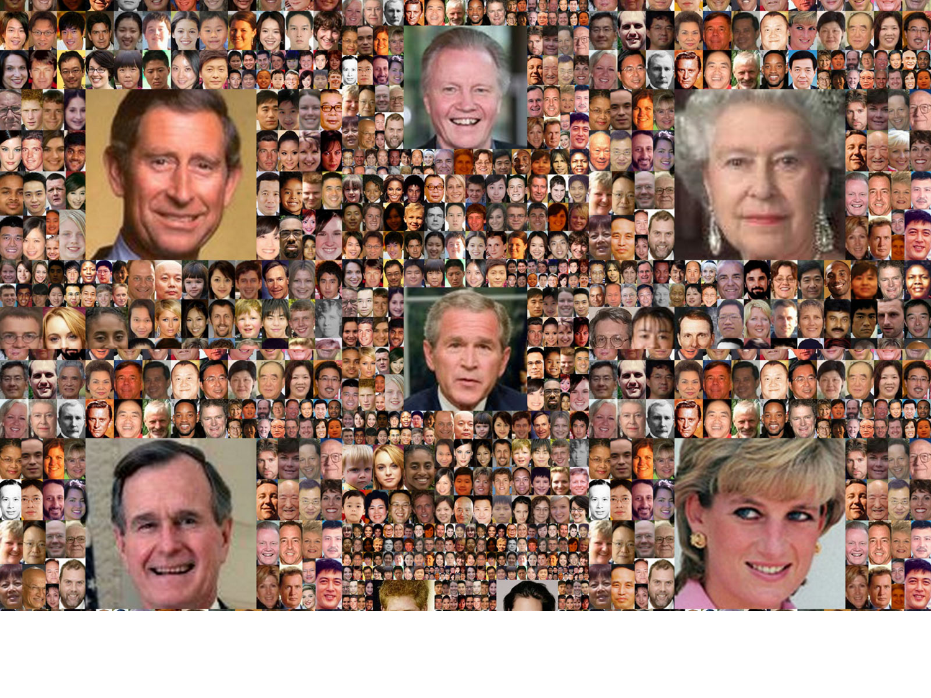
Datasets
A dataset is a collection of curated data
Images
Measurements (time, views, inches, etc)
Text
Video recordings!
Notes:
Isn’t just numbers -- weather data vs. online video data (gives you information)
Have you ever collected a dataset??

Slide 9
AI has three parts
dataset
Notes:
Short definition

Slide 10
AI has three parts
dataset
learning algorithm
Notes:
Talk about all day tomorrow. What do you think of? What does it mean to learn? Does anyone know the world algorithm?

Slide 11
What is an
“algorithm”?

Slide 12
Algorithm
Steps to change input
output
input
Notes:
Artificial intelligence is a kind of algorithm… theres other kinds as well

Slide 13
Adding a contact to your phone
Open address book app
Fill out first name
Fill out last name
Add phone number
Save!
Output:
A new contact in your phone
Input:
Contact’s name
Phone number

Slide 14
AI has three parts
dataset
learning algorithm
Notes:
Short definition

Slide 15
Algorithm
learning algorithm
prediction!
dataset

Slide 16
Let’s try some examples

Slide 17
Instagram advertisement
prediction?
Notes:
What is instagrams algorithm trying to pick? What kinds of ads do you get? What do you think they are trying to do?

Slide 18
Instagram advertisement
What you will click on

Slide 19
Instagram advertisement
learning algorithm
What you will click on

Slide 20
Instagram advertisement
learning algorithm
What you will click on
dataset?
Notes:
What kind of dataset do you think this learning algorithm is learning from… do you notice patterns?

Slide 21
Instagram advertisement
learning algorithm
What you will click on
Past clicks
Brands you follow and people like you
Text in captions

Slide 22
EMAIL SpAM filter
learning algorithm
prediction!
dataset

Slide 23
EMAIL SpAM filter
prediction?

Slide 24
EMAIL SpAM filter
If email is spam or not

Slide 25
EMAIL SpAM filter
learning algorithm
If email is spam or not

Slide 26
Email Spam Filter
learning algorithm
If email is spam or not
dataset?

Slide 27
Email spam Filter
learning algorithm
If email is spam or not
Past emails you have labeled as spam
Text of emails

Slide 28
Time for AI Bingo!

